Slide 1
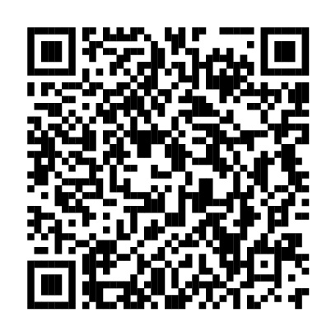
Sabatolimab (MBG453) Dose Selection and Dose-Response Analysis in Myelodysplastic Syndrome/ Acute Myeloid Leukemia: Population Pharmacokinetics Modeling and Evaluation of Clinical Efficacy/Safety by Dose
Poster 2192
Andrew H. Wei
andrew.wei@monash.edu
Scan to obtain
Andrew H. Wei,¹ Jordi Esteve,² Kimmo Porkka,³ Steve Knapper,⁴ Norbert Vey,⁵ Sebastian Scholl,⁶ Guillermo Garcia-Manero,⁷ Martin Wermke,⁸ Jeroen Janssen,⁹ Elie Traer,¹⁰ Sun Loo,¹¹ Rupa Narayan,¹² Natalia Tovar,² Mika Kontro,³ Oliver Ottmann,⁴ Siyan Xu,¹³ Andrew Lewandowski,¹³ Andrew Stein,¹³ Fariba Khanshan,¹³ Purushotham Naidu,¹⁴ Wei He,¹³ Anisa Mohammed,¹⁴ Mikael L. Rinne,¹³ Haiying Sun,¹⁴ Andrew M. Brunner,¹²* Uma Borate¹⁰*
*Co-senior authors Andrew Brunner and Uma Borate contributed equally to this work.
Poster
Supplementary material
http://www.medcommshydhosting.com/Oncology/Hematology/KnowledgeCenter/ASH2020/MDS_AML_AdvSM/index.html
¹The Alfred Hospital and Monash University, Melbourne, Victoria, Australia; ²Hospital Clínic, Barcelona, Spain; ³Helsinki University Hospital Comprehensive Cancer Center, Department of Hematology, Helsinki, Finland; ⁴Cardiff University, Cardiff, UK; ⁵Institut Paoli-Calmettes, Marseille, France; ⁶University Hospital Jena, Jena, Germany; ⁷MD Anderson Cancer Center, Houston, TX; ⁸University Hospital Dresden, Dresden, Germany; ⁹Amsterdam University Medical Centers, VU University Medical Center, Amsterdam, The Netherlands; ¹⁰Oregon Health & Science University, Portland, OR; ¹¹The Alfred Hospital, Melbourne, Victoria, Australia; ¹²Massachusetts General Hospital, Boston, MA; ¹³Novartis Institutes for BioMedical Research, Cambridge, MA; ¹⁴Novartis Pharmaceuticals Corporation, East Hanover, NJ
Copies of this poster obtained through QR (Quick Response) code are for personal use only and may not be reproduced without permission of the authors.

Slide 2
Disclosures
AHW reports consultancy for Servier, BMS; honoraria for AbbVie, Servier, Novartis, AstraZeneca, Pfizer, BMS, Janssen, Amgen, Astellas, Genentech, and Celgene; research funding from Abbvie, Servier, Novartis, AstraZeneca, BMS, Amgen, and Celgene; speakers bureau for AbbVie, BMS, and Novartis; patents and royalties from Walter and Eliza Hall Institute of Medical Research; membership on an entity’s Board of Directors or advisory committees for Astellas, Genentech, and Celgene. KP reports consultancy for Novartis; honoraria and research funding from Novartis and BMS/Celgene. SK reports honoraria, membership on an entity’s Board of Directors or advisory committee and research funding for Novartis. GG-M reports consultancy for Acceleron Pharmaceuticals, Astex Pharmaceuticals, Bristol-Myers Squibb, Celgene, Helsinn Therapeutics, Jazz Pharmaceuticals, and Genentech; honoraria for AbbVie, Acceleron Pharmaceuticals, Astex Pharmaceuticals, Celgene, and Helsinn Therapeutics; research funding from AbbVie, Amphivena Therapeutics, Astex Pharmaceuticals, Bristol-Myers Squibb, Celgene, Helsinn Therapeutics, H3 Biomedicine, Merck, Novartis, Genentech, and Onconova; membership on an entity’s Board of Directors or advisory committees for Genentech. MW reports honoraria for MacroGenics. JJ reports honoraria for Novartis, Pfizer, and Incyte; research funding from Novartis, and BMS, membership on an entity’s Board of Directors or advisory committees for Novartis, Pfizer, AbbVie, and Incyte; Founder of the HematologyApp which is supported by Janssen, BMS Incyte, MDS, Pfizer, Daiichi-Sankyo, Roche and Takeda. ET reports consultancy for AbbVie, and Notable Labs; research funding for Incyte; membership on an entity’s Board of Directors or advisory committees for Agios, Genentech, AbbVie, Astellas, and Daiichi Sankyo; current equity holder in private company with Notable Labs. RN reports current spouse employment with Sanofi-Genzyme; prior spouse employment within 24 months with Takeda; prior spouse employment within 24 months and prior spouse equity divested within past 24 months with Genentech. MK reports consultancy with Astellas; research funding with AbbVie; membership on an entity’s Board of Directors or advisory committees with Jazz Pharma, Astellas, Novartis, and Celgene; speakers bureau with Novartis, and Celgene. OO reports honoraria for Novartis, Amgen, Celgene, Fusion Pharma, and Incyte; research funding from Amgen, Celgene, and Incyte. MLR reports employment at Novartis and consultancy for Qiagen. AMB reports consultancy for Acceleron Pharma Inc., Biogen, Celgene/BMS, Forty Seven, Inc., Jazz Pharma, Novartis, Takeda, and Xcenda, research funding from Celgene/BMS, Novartis, Takeda, GSK, Janssen, and AstraZeneca. UB reports research funding from Takeda, Novartis, Jazz Pharmaceuticals, and Pfizer; membership on an entity’s Board of Directors or advisory committees for Genentech, Daiichi Sankyo, Takeda, Novartis, and Pfizer; investigator in AbbVie-funded clinical trials. SX, AL, AS, FK, PN, WH, AM, and HS are employees at Novartis. All other authors had nothing to disclose

Slide 3
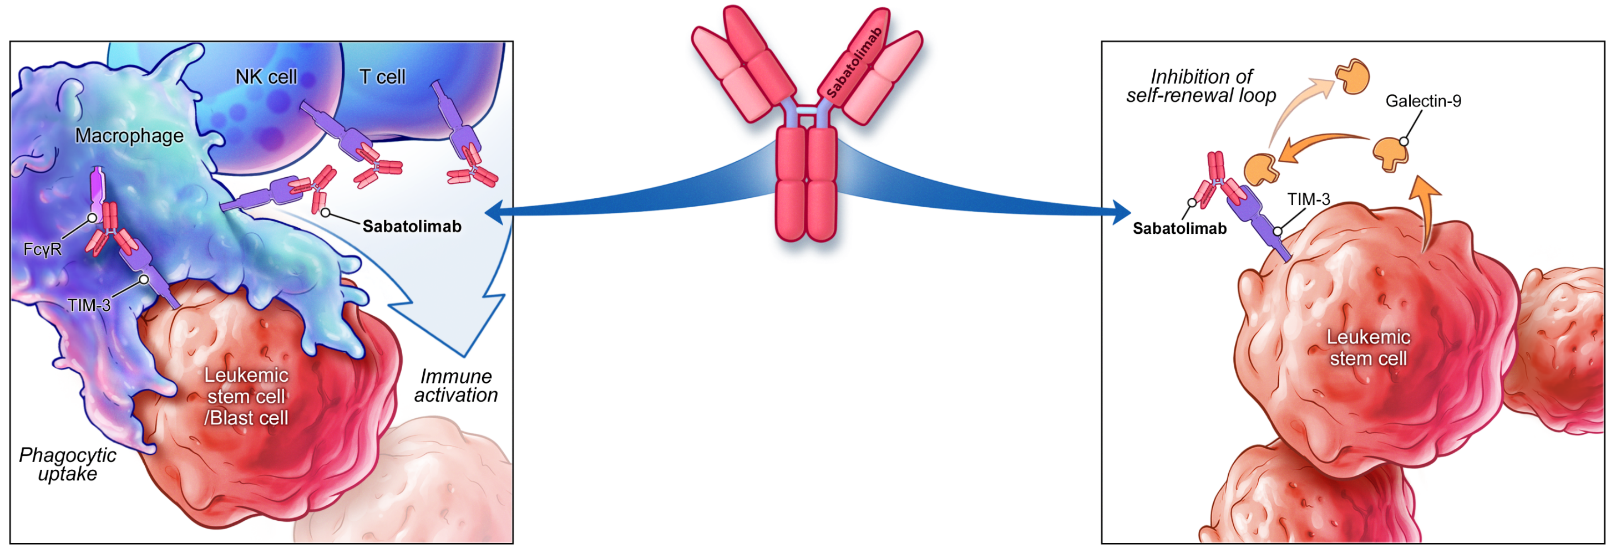
Sabatolimab (MBG453) Provides Dual Targeting of TIM-3 on Immune and Leukemic Cells
TIM-3
Sabatolimab
Inhibitory receptor expressed on macrophages, monocytes, NK cells, dendritic cells, and T cells^{1,2}
Involved in regulating innate and adaptive immune responses^{1,2}
Expressed on LSCs/blasts but not normal HSCs,^{3,4} making it a promising target in MDS/AML⁴⁻⁶
High-affinity, humanized, IgG4 anti–TIM-3 monoclonal antibody^{6,7}
Enhances antileukemia immune activation and phagocytic uptake, facilitating immune cell-mediated killing of LSCs/blasts^{2,7-9}
May inhibit TIM-3/galectin-9–driven LSC self-renewal via blockade of TIM-3 on LSCs²⁻⁹
AML, acute myeloid leukemia; FcɣR, Fc gamma receptor; HSC, hematopoietic stem cell; IgG4, immunoglobulin G4; LSC, leukemic stem cell; MDS, myelodysplastic syndrome; NK, natural killer; TIM-3, T-cell immunoglobulin domain and mucin domain-3. 1. Wolf Y, et al. Nat Rev Immunol. 2020;20(3):173-85; 2. Acharya N, et al. J Immunother Cancer. 2020;8(1):e000911; 3. Haubner S, et al. Leukemia. 2019;33(1):64-749; 4. Asayama T, et al. Oncotarget. 2017;8(51):88904-917; 5. Kikushige Y, et al. Cell Stem Cell. 2015;17(3):341-52; 6. Mach N, et al. Ann Oncol. 2019;30(suppl 5):abstract 1202P; 7. Borate U, et al. HemaSphere. 2020;4(suppl 1):abstract S185; 8. Borate U, et al. EHA 2020. Oral presentation; 9. Sabatos-Peyton C, et al. SITC 2020. Abstract 439.

Slide 4

Evaluation of Sabatolimab Pharmacokinetics and Dose Response in Early Clinical Studies
Analysis endpoints^{c}
PK parameters
Steady-state C_{avg}, C_{max}, and C_{trough} (PopPK modeling)
Total serum soluble TIM-3 concentration
Solid tumors
Phase I-Ib/II
NCT02608268
Sabatolimab
80-1200 mg Q2W/Q4W
Sabatolimab
20-800 mg Q2W/
80-1200 mg Q4W
Spartalizumab
(PD-1 inhibitor)
MDS, AML, or CMMLª
Phase Ib
NCT03066648^{b}
Sabatolimab
160-1200 mg Q2W/ 800 mg Q4W
Sabatolimab
240 mg or 400 mg Q2W, 800 mg Q4W
Decitabine/
Azacitidine
Sabatolimab
160-1200 mg Q2W/
800 mg Q4W
Spartalizumab ± decitabine
ªSabatolimab + decitabine/azacitidine arm included adult patients with vHR/HR-MDS or AML who were ineligible for intensive chemotherapy; ^{b}Dosing used in vHR/HR-MDS and AML patients were based on findings from the NCT02608268 study; ^{c}All endpoints had a data cutoff date of November 27, 2019, except for AEs and response rates by sabatolimab dose, which had a data cutoff date of September 22, 2020.
AE, adverse event; C_{avg}, average concentration; C_{max}, maximum concentration; C_{trough}, trough concentration; CMML, chronic myelomonocytic leukemia; HR, high-risk; PD-1, programmed death-1; PK, pharmacokinetics; Pop, population; Q2W, every 2 weeks; Q4W, every 4 weeks; vHR, very high-risk.
Notes:
Note that this slide “builds” with the next slide
The analyses reported here included data from two early phase clinical trials of sabatolimab in either advanced solid tumors or high-risk MDS, AML, or CMML
Initial PK assessments were conducted in the solid tumors study using a broader range of sabatolimab doses; findings from these assessments informed the selection of doses that were evaluated in the MDS/AML/CMML study
Among the analysis endpoints reported in this presentation, the three shown here were based on data from both studies
Advance to next slide

Slide 5

Evaluation of Sabatolimab Pharmacokinetics and Dose Response in Early Clinical Studies
Analysis endpoints^{c}
PK parameters
Steady-state C_{avg}, C_{max}, and C_{trough} (PopPK modeling)
Total serum soluble TIM-3 concentration
Solid tumors
Phase I-Ib/II
NCT02608268
Sabatolimab
80-1200 mg Q2W/Q4W
Sabatolimab
20-800 mg Q2W/
80-1200 mg Q4W
Spartalizumab
(PD-1 inhibitor)
MDS, AML, or CMMLª
Phase Ib
NCT03066648^{b}
Sabatolimab
160-1200 mg Q2W/ 800 mg Q4W
Predicted membrane-bound TIM-3 occupancy
Correlation of steady-state exposure with AEs and clinical benefit
AEs and response rates by sabatolimab dose
Sabatolimab
240 mg or 400 mg Q2W, 800 mg Q4W
Decitabine/
Azacitidine
Sabatolimab
160-1200 mg Q2W/
800 mg Q4W
Spartalizumab ± decitabine
ªSabatolimab + decitabine/azacitidine arm included adult patients with vHR/HR-MDS or AML who were ineligible for intensive chemotherapy; ^{b}Dosing used in vHR/HR-MDS and AML patients were based on findings from the NCT02608268 study; ^{c}All endpoints had a data cutoff date of November 27, 2019, except for AEs and response rates by sabatolimab dose, which had a data cutoff date of September 22, 2020.
AE, adverse event; C_{avg}, average concentration; C_{max}, maximum concentration; C_{trough}, trough concentration; CMML, chronic myelomonocytic leukemia; HR, high-risk; PD-1, programmed death-1; PK, pharmacokinetics; Pop, population; Q2W, every 2 weeks; Q4W, every 4 weeks; vHR, very high-risk.
Notes:
These additional three endpoints were based on data from the MDS/AML/CMML study, and AE and efficacy data were from the sabatolimab plus HMA treatment arms
All endpoints had a data cutoff date of November 2019, except for the analysis of AEs and response rates by sabatolimab dose, which had a data cutoff date of September 2020—additional results from this latest data cut are also being reported in an oral presentation on Monday, December 7

Slide 6
Saturation of sTIM-3 Was Achieved With Sabatolimab Doses ≥240 mg Q2W and ≥800 mg Q4W
Solid tumor
In patients with solid tumors, sabatolimab doses ≥240 mg Q2W or ≥800 mg Q4W showed
Plateau in accumulated total sTIM-3
Proportional dose-exposure relationship
2000
1000
500
200
Q2W
100
50
10
2000
1000
500
200
Q4W
100
50
10
0
1
2
3
4
5
6
7
8
9
10
11
Time, mo
Sabatolimab dose
1200 mg
400 mg
80 mg
800 mg
240 mg
20 mg
Notes:
Note that this slide “builds” with the next slide
Results from the solid tumors study showed that with sabatolimab doses of 240 mg and above for the Q2W regimen, and 800 mg and above for the Q4W regimen, a plateau in the accumulated total soluble TIM-3 was reached
Soluble TIM-3 is used as an indirect measure of the level of engagement of cell surface (or membrane-bound) TIM-3 by sabatolimab
Sabatolimab binding stabilizes soluble TIM-3, increasing its measurable concentration
The concentration plateau seen here reflects saturation of soluble TIM-3 by sabatolimab, which can be used to infer a high level of engagement of membrane-bound TIM-3 by sabatolimab
In addition, these sabatolimab doses resulted in a proportional dose-exposure relationship...
Advance to next slide

Slide 7
Saturation of sTIM-3 Was Achieved With Sabatolimab Doses ≥240 mg Q2W and ≥800 mg Q4W
Solid tumor
MDS/AML/CMML
In patients with solid tumors, sabatolimab doses ≥240 mg Q2W or ≥800 mg Q4W showed
Plateau in accumulated total sTIM-3
Proportional dose-exposure relationship
2000
1000
500
200
Q2W
Q2W
100
50
10
2000
1000
500
200
Q4W
Q4W
Similar results were observed in the study in patients with MDS/AML/CMML
100
50
10
0
1
2
3
4
5
6
7
8
9
10
11
0
1
2
3
4
5
6
7
8
9
10
11
Time, mo
Sabatolimab dose
1200 mg
400 mg
80 mg
800 mg
240 mg
20 mg
Notes:
...and similar results were observed in the MDS/AML/CMML study
Overall, these findings indicated that sabatolimab doses of 240 mg and above Q2W, and 800 mg and above Q4W, would provide high levels of engagement of membrane-bound TIM-3 by sabatolimab

Slide 8
Receptor Occupancy Modeling Indicated Similarly High Levels of TIM-3 Engagement With Sabatolimab 400 mg Q2W and 800 mg Q4W
Population PK modeling with
sabatolimab + HMA regimens
Simulated steady-state occupancy of membrane-bound TIM-3 in bone marrowª
Q2W Regimen
400 mg Q2W had the highest C_{trough} at steady state
800 mg was predicted to be an equivalent Q4W dosing regimen
Both doses had similar steady-state C_{avg}
99.9
99
95
90
50
0
TIM-3 receptor occupancy (%)
Q4W Regimen
99.9
99
95
90
50
0
20
40
80
160
240
400
800
1200
Sabatolimab dose (mg)
Shaded region denotes 5%-95% prediction interval
>95% occupancy rate in bone marrow in ≥95% of patients with vHR/HR-MDS, AML, or CMML
Notes:
Further evaluation, via population PK modeling, of sabatolimab 240 mg Q2W, 400 mg Q2W, and 800 mg Q4W in combination with HMA showed that the 400 mg Q2W dosing regimen was predicted to provide the highest sabatolimab trough serum concentration at steady state
An 800 mg dose given Q4W was predicted to be an equivalent dosing regimen
Both 400 mg Q2W and 800 mg Q4W provided similar sabatolimab average serum concentrations at steady state
Receptor occupancy modeling showed that 400 mg Q2W and 800 mg Q4W provided similarly high levels of membrane-bound TIM-3 occupancy in the bone marrow, with a >95% occupancy rate in ≥95% of patients with high-risk MDS, AML, or CMML

Slide 9
PK Exposure-Response Analyses With Sabatolimab + HMA Showed Similar Safety and Efficacy Across Sabatolimab Exposure Levels
PK exposure-AE relationship (n=102ª)
PK exposure-efficacy relationship (n=92ª)
AML MDS/CMML Sabatolimab + decitabine Sabatolimab + azacitidine
Max grade
No AE
1
2
3
4
200
150
20
100
C_{trough} at steady state (µg/mL)
Patients (n)
Best % reduction in bone marrow blasts
100
10
0
50
0
-100
[55.4, 119]
[119, 171]
[171, 225]
[225, 471]
50
100
150
Clinical benefit
No clinical benefit
C_{max} at steady state (µg/mL)
C_{trough} at steady state (µg/mL)
Patients were categorized into 4 exposure quartiles based on steady-state C_{max} and C_{avg}
No relationship between steady-state C_{max} or C_{avg} and treatment-related AEs
No relationship between steady-state C_{trough} or C_{avg} and % blast cell reduction or clinical benefit (ie, CR, mCR, CRi, and PR)
Notes:
PK exposure-response analyses were conducted with sabatolimab 240 mg Q2W, 400 mg Q2W, and 800 mg Q4W in combination with HMA
To evaluate the relationship between PK exposure and AEs, patients were divided into 4 exposure quartiles based on sabatolimab maximal and average serum concentrations at steady state
No relationship was seen between sabatolimab PK exposure and the incidence of treatment-related AEs
The relationship between PK exposure and efficacy was evaluated based on percent reduction from baseline in bone marrow blasts, and also on achievement of clinical benefit (defined as CR, mCR, CRi, or PR)
No relationship was observed between sabatolimab PK exposure and these efficacy parameters
These results show similar safety and efficacy with sabatolimab plus HMA across the three dosing regimens tested

Slide 10
Sabatolimab + HMA Was Safe Overall, With Encouraging Efficacy Across Doses in vHR/HR-MDS or AML
Clinical safety by sabatolimab dose
(n=118)
Clinical efficacy by sabatolimab dose
(n=104)
 | vHR/HR-MDS and AML
Sabatolimab dose | 240 mg Q2W | 400 mg Q2W | 800 mg Q4W
Safety population, n | 30 | 50 | 38
Most commonª TEAEs grade ≥3, n (%)
Neutropenia | 15 (50.0) | 20 (40.0) | 17 (44.7)
Thrombocytopenia | 13 (43.3) | 16 (32.0) | 20 (52.6)
Febrile neutropenia | 17 (56.7) | 14 (28.0) | 14 (36.8)
Anemia | 9 (30.0) | 12 (24.0) | 14 (36.8)
Pneumonia | 2 (6.7) | 8 (16.0) | 5 (13.2)
Treatment-related possible imAEs grade ≥3,^{b} n (%) | 4 (13.3) | 0 | 2 (5.3)
vHR/HR-MDS evaluable patients
AML evaluable patients
50.0% | 46.2% | 57.1%
35.3% | 34.5% | 31.6%
Sabatolimab doses
Sabatolimab doses
Rates of clinically significant (grade ≥3) TEAEs and possible imAEs related to treatment did not appear to be dose dependent
To date, among the 3 sabatolimab dosing regimens tested:
No notable differences in efficacy
No significant association with duration of response (Cox model with dose as a covariate)

Slide 11
1. Sabatolimab 400 mg Q2W was predicted to have the highest steady state C_{trough} and TIM-3 occupancy rate when combined with HMA; 800 mg was predicted to be an equivalent Q4W dosing regimen
2. Sabatolimab 400 mg Q2W and 800 mg Q4W provided similarly high levels of TIM-3 engagement based on analysis of sTIM-3 concentration and receptor occupancy modeling
3. Sabatolimab + HMA showed promising efficacy and good safety/tolerability in patients with vHR/HR-MDS and AML at both 400 mg Q2W and 800 mg Q4W, with no clear relationship between sabatolimab dose/exposure and safety/efficacy
4. These results validate the selection of the 400 mg Q2W and 800 mg Q4W dosing regimens for the STIMULUS clinical trial program
Updated clinical data from Phase 1b study of sabatolimab + HMA in MDS/AML: Brunner AM et al. Oral presentation #657; Monday, December 7, 2020; 12:30 pm
STIMULUS TiP poster: Zeidan AM, et al; Poster 1294; December 5-8, 2020

Slide 12
Acknowledgments
Andrew H. Wei
andrew.wei@monash.edu
The authors thank the patients who participated in the trial and their families
This study was funded by Novartis Pharmaceuticals Corporation
Editorial assistance was provided by Jasmine Javier, MD, of Healthcare Consultancy Group, LLC, and funded by Novartis Pharmaceuticals Corporation
Scan to obtain
Poster
Supplementary material
http://www.medcommshydhosting.com/Oncology/Hematology/KnowledgeCenter/ASH2020/MDS_AML_AdvSM/index.html
Copies of this poster obtained through QR (Quick Response) code are for personal use only and may not be reproduced without permission of the authors.

Slide 13
Supplementary material for associated poster presentation
Poster 2192
Andrew H. Wei
andrew.wei@monash.edu
Sabatolimab (MBG453) Dose Selection and Dose-Response Analysis in Myelodysplastic Syndrome/Acute Myeloid Leukemia: Population Pharmacokinetics Modeling and Evaluation of Clinical Efficacy/Safety by Dose

Slide 14
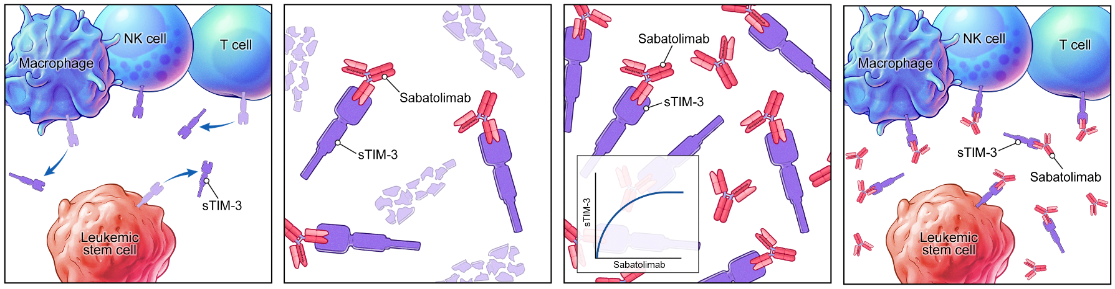
Soluble TIM-3 (sTIM-3) concentration as an indicator of sabatolimab binding to TIM-3 on the cell surface
TIM-3 is a cell surface receptor but can be shed from immune and leukemic cells as soluble TIM-3 (denoted “sTIM-3”).
The binding of sabatolimab to sTIM-3 results in the stabilization of sTIM-3.
As sabatolimab increases, more sTIM-3 is bound and the measured concentration of sTIM-3 increases. Saturation of sTIM-3 can be seen as a concentration plateau.
Because sabatolimab binds both soluble and cell surface TIM-3, the saturation of sTIM-3 can be used to infer a high level of engagement of cell surface TIM-3.

Slide 15
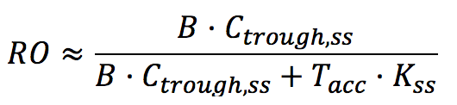
Sabatolimab C_{trough,ss} was simulated from the PopPK model, and used to predict RO and support dose selection
PK Model
Circulation
Sabatolimab (C_{trough,ss})
Model Simulation
mTIM-3 target engagement in tumor
Dose Selection
Report RO at doses of interest
Equation for predicting RO in bone marrow¹
Assumptions for RO Simulation
Bone marrow drug concentration is 20-40% of circulation concentration (B)
Membrane-bound TIM-3 after sabatolimab binding is 50-100% its levels at baseline (Tacc)
Sabatolimab concentration is much greater than TIM-3 concentration
Binding affinity for mTIM-3 is 0.5 nM (Kss)
1. Ahmed S, et al. J Pharmacokinet Pharmacodyn. 2019;46:287-304. B, bone marrow drug concentration; C, concentration; Kss, quasi-steady-state binding constant for membrane-bound TIM-3; mTIM-3, membrane-bound TIM-3; RO, receptor occupancy; ss, steady state; Tacc, fold change in membrane-bound TIM-3; TIM-3, T-cell immunoglobulin domain and mucin domain-3.

